Slide 1
DataHub Discovery Workshop
Prerequisites
Jan 2022

Slide 2
Agenda
Architecture Review
Requirements
Disclaimers
Planning

Slide 3
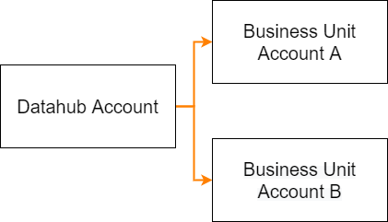
Architecture Review – High level overview
3 AWS accounts are required for this initial deployment

Slide 4
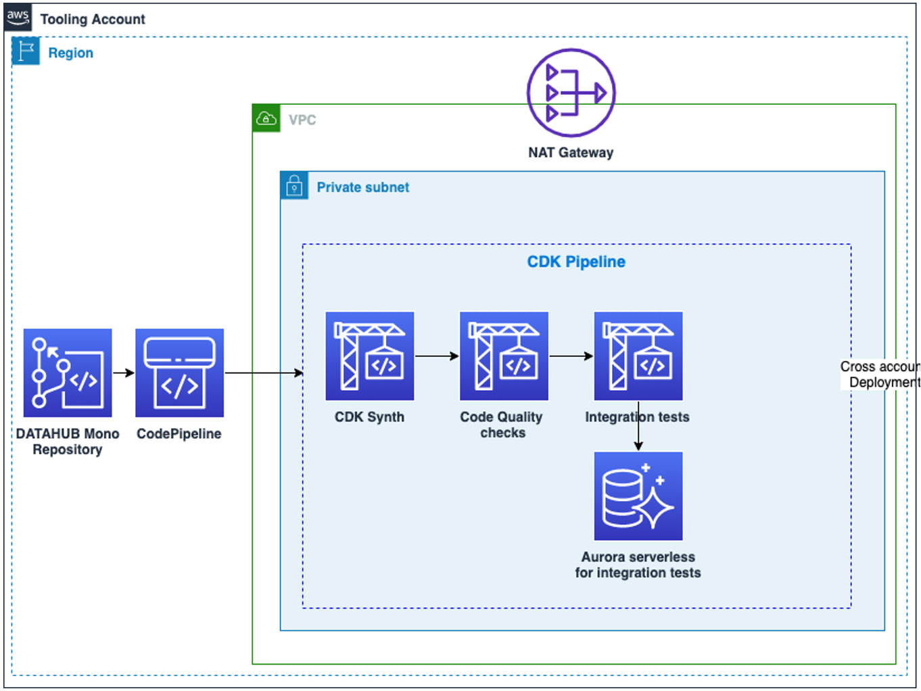
Architecture Review – Datahub account – CI/CD pipeline
The CI/CD pipeline is deployed in the Datahub account
It deploys the Datahub application through CloudFormation

Slide 5
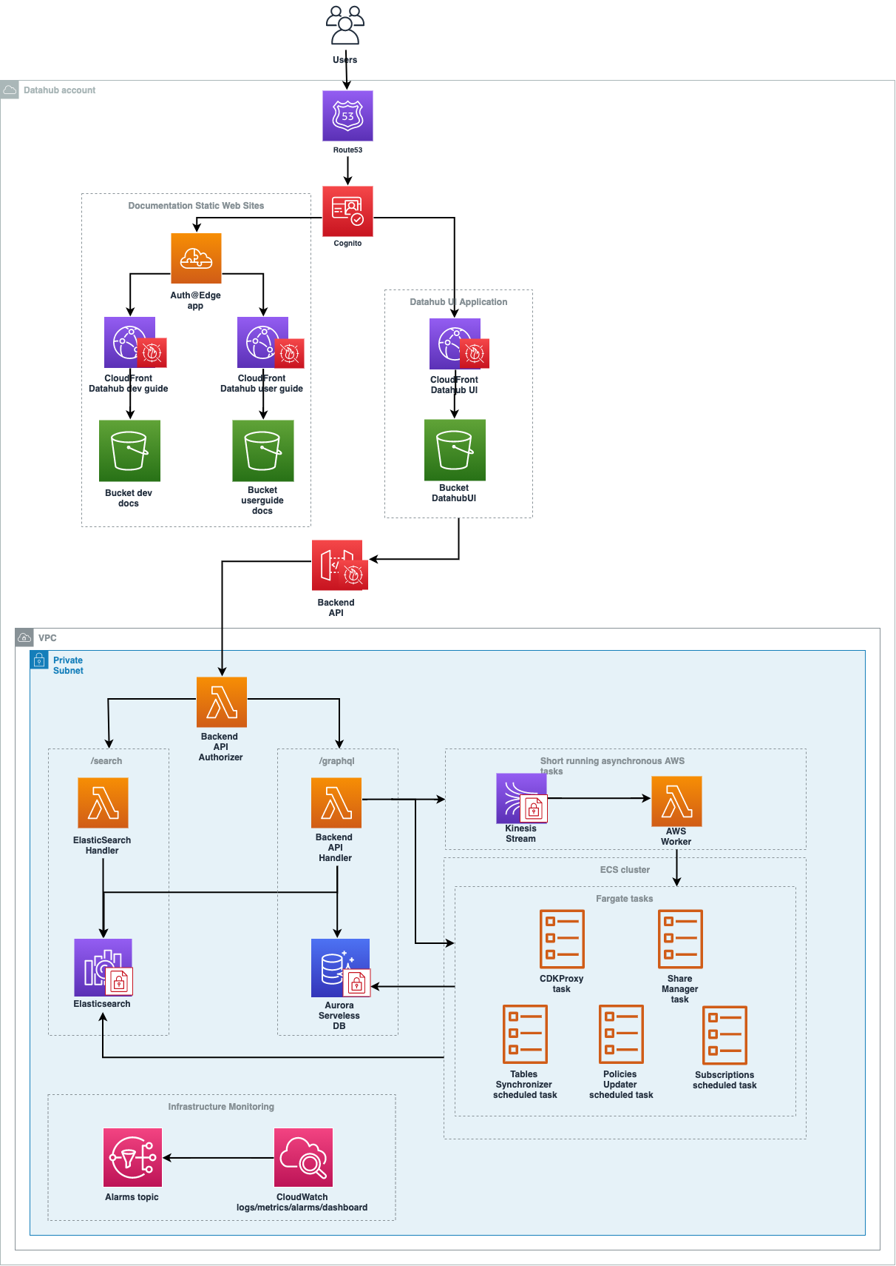
Architecture Review – Datahub account
The datahub infrastructure is deployed via a CDK project and a CI/CD pipeline
Fargate tasks create resources (datasets, notebook…) in Business Unit accounts through IAM cross account permissions

Slide 6
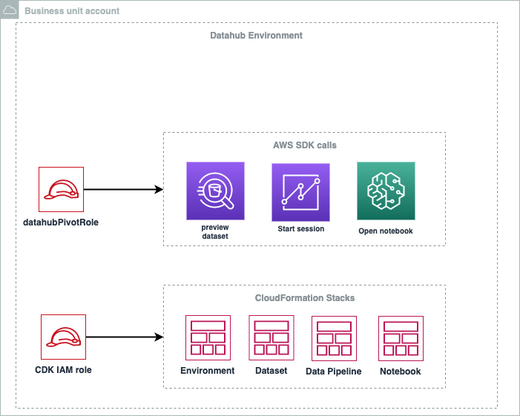
Architecture Review – Business unit accounts
The two IAM roles are assumed by Datahub to create resources in Business Unit accounts.
Data remains in Business unit accounts.
AWS Lake Formation is enabled in the Business Unit accounts to manage data sharing.

Slide 7
Requirements Summary
3 « Lab » AWS accounts:
1 tooling account
2 Business Unit accounts
AWS Consultants need privileged access to the accounts.
Ability to create VPCs in each account.
AWS Lake formation and Amazon Quicksight (Enterprise subscription) enabled on Business Unit accounts.
1 week prior to the workshop, an initial test deployment will be ran by AWS.

Slide 8
Disclaimers
Important note for this first deployment
Only non-production data will be manipulated.
The deployment of Datahub requires a code repository: AWS CodeCommit in the tooling account by default.
Amazon Cognito will be used to authenticate users. No federation will be implemented for this initial deployment.
Some resources will be internet facing (Amazon Cloudfront, AWS API Gateway) but protected by Cognito and AWS WAF.
This exercise is intended to be a sandbox deployment. For a production deployment, further customization is possible.

Slide 9
Planning
 | Duration | Target Audience | Content
Deploying Datahub with CUSTOMER | 1 day | DevOps | In this module, Consultants will perform an end-to-end deployment of the web application alongside CUSTOMER engineers.
Code review | ½ day | Dev, DevOps | In this module, we will dive deeper into the application code, to help the customer understand how to iterate & evolve the existing solution to match their needs.
Infrastructure deep-dive | ½ day | Cloud Engineers | In this module, we will dive into the intricacies of the deployed architectures, and try to understand what questions it may raise in terms of integration, namely regarding compliance & security.
Hands-on session: Data Discovery, Data Sharing, Data Consumption | 1 day | Datahub end users (data scientists, business analysts, data engineers, etc.) | In this module, we will gain practical experience with Datahub, and explore the Catalog, Dataset sharing, Notebooks, Worksheets & Dashboards features
Tech demo: Build ETL pipelines with dbt & Glue | 2 hours | Data Engineers | This is a demo on how to integrate the dbt framework with Glue Interactive Sessions to enhance the data pipeline creation experience.
Action plan for production deployment | ½ day | DevOps | Using questions raised during the previous modules, we will draft an action plan (timeline, team, risks) to move datahub to a production workload at CUSTOMER.

